Slide 1

Introduction of AI Model of Wire Bond Parameter for Bond Shear Test Prediction
October 2021
& CIM

Slide 2
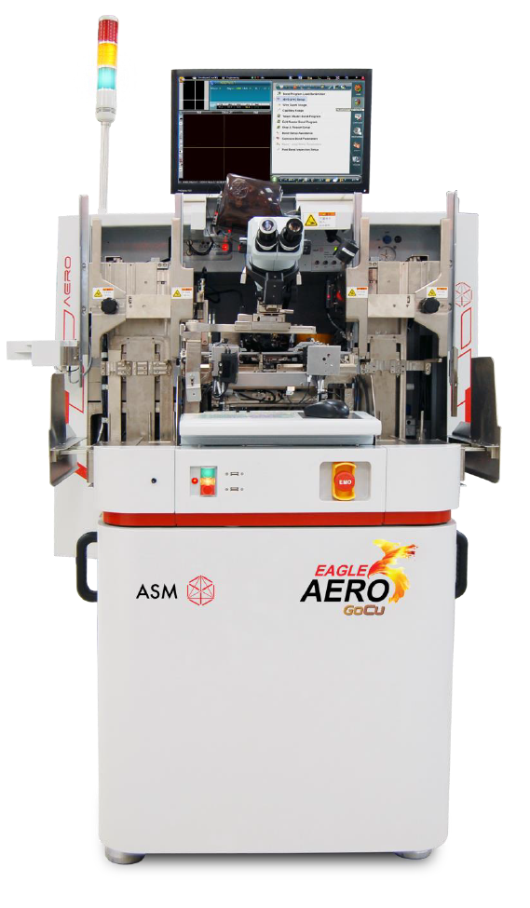

Genesis AI Model In house Development Process
Data Collection
Data Preprep
Model Development
ActiveL
SPC
Bond Shear Recording
Data Cleansing
Parameter Selection
AI Model Development
CIM
Raw Data
Training Data
80%
Training
Wire Bonder Parameters by SECS/GEMS
Testing Data
20% Unseen
Testing

Slide 3
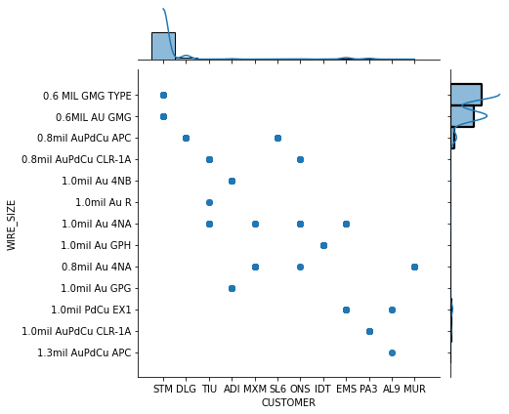
Training Dataset
Overall Visualization
Training Data
Training Data Description
40,308 Records of 35 Parameters
85 Machine of Wire Bonders
Data period 2.38 Days
First 07/22/2021 0:09
Last 07/24/2021 9:10

Slide 4
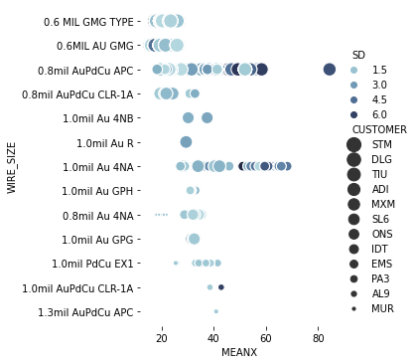
Training Dataset
Bond Shear Visualization
Training Dataset
EN_NO
DEVICE
REMARK
SUBGRP
WIRE_SIZE
MEANX
PLANT_ID
SD
BOM_NO
MC_ID
MC_NO
COUNTER
CHAR_MINOR
PACKAGE
DATE_
CIMprofile.cim_machine_name
Parameter.Group
Parameter.DataType
Parameter.Unit
Parameter.Valid
Parameter.No
Parameter.BondType
Parameter.No_1
Parameter.Value
Parameter.Max
Parameter.Min
Parameter.CreateTime
Parameter.EquipOpn
Parameter.EquipID
Parameter.ULotID

Slide 5

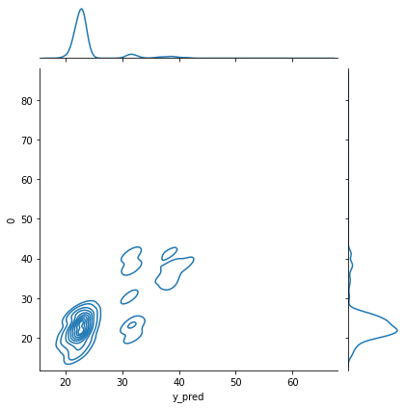
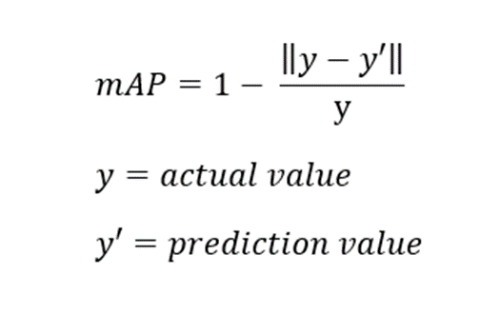
Prediction Visualization
Unseen 8,063 Dataset
EN_NO
DEVICE
REMARK
SUBGRP
WIRE_SIZE
MEANX
PLANT_ID
SD
BOM_NO
MC_ID
MC_NO
COUNTER
CHAR_MINOR
PACKAGE
DATE_
CIMprofile.cim_machine_name
Parameter.Group
Parameter.DataType
Parameter.Unit
Parameter.Valid
Parameter.No
Parameter.BondType
Parameter.No_1
Parameter.Value
Parameter.Max
Parameter.Min
Parameter.CreateTime
Parameter.EquipOpn
Parameter.EquipID
Parameter.ULotID
82.4% mAP*
Model Type :
Neural Network (MLP)
* mAP (Mean Average Precision)

Slide 6

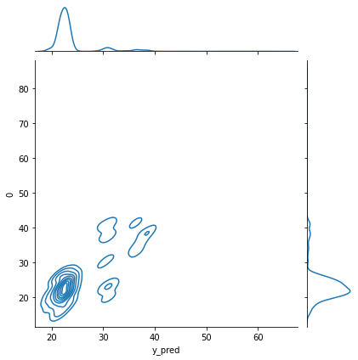
Prediction Visualization
Unseen 8,063 Dataset
EN_NO
DEVICE
REMARK
SUBGRP
WIRE_SIZE
MEANX
PLANT_ID
SD
BOM_NO
MC_ID
MC_NO
COUNTER
CHAR_MINOR
PACKAGE
DATE_
CIMprofile.cim_machine_name
Parameter.Group
Parameter.DataType
Parameter.Unit
Parameter.Valid
Parameter.No
Parameter.BondType
Parameter.No_1
Parameter.Value
Parameter.Max
Parameter.Min
Parameter.CreateTime
Parameter.EquipOpn
Parameter.EquipID
Parameter.ULotID
90.1% mAP*
Model Type :
Random Forest Regression
* mAP (Mean Average Precision)

Slide 7
Introduction of AI Model of Wire Bond Parameter
for Bond Shear Prediction
Summary
The Genesis AI model performance has some level of prediction
The Distribution of Training Dataset has potential to influence the model performance
What should be next
Get more Wire bond Parameter that has strong relationship with Bond Shear
Improve Distribution of Training Dataset to avoid bias effect.

Slide 8
Introduction of AI Model of Wire Bond Parameter
for Bond Shear Prediction
Feed Back, Question & Answer
Thank You

Slide 9
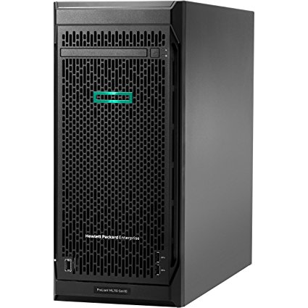
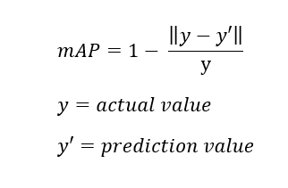
UTAC
AI

